Slide 1
第十六章 汽车自动变速器
Chapter 16
Vehicle automatic transmission

Slide 2
主要内容 MAIN CONTENTS
自动变速器的分类 Classification
液力耦合器与液力变矩器的工作原理 The working principle of fluid coupling and torque converter
液力机械变速器的结构与原理 The structure and principle of hydraulic mechanical transmission
自动变速器的操纵机构 The operating mechanism of automatic transmission
金属带式无级变速器 Metal Belt Continuously Variable transmission(CVT)

Slide 3
第一节 概 述
Section 1 Overview
自动变速器定义：根据发动机负荷和汽车车速等工况自动变换传动系统的传动比，以使汽车获得良好的动力性和燃油经济性，并减少发动机的排放以及提高车辆行驶的安全性、乘坐舒适性和操纵轻便性。
Definition of Automatic Transmission：One type of motor vehicle transmission that can automatically change gear ratios of transmission system according the working conditions such as engine load and vehicle speed, so that to make the vehicle to obtain good power performance and fuel economy, and reduce engine emissions ,and improve the driving safety and riding comfort and handling easiness.

Slide 4
自动变速器分类 Classification
按传动比的变化范围Variation range of transmission radio:
有级式自动变速器Stepped type
无级式自动变速器Stepless type
综合式自动变速器Hydraulic-mechanical
又称为电控机械自动变速器（AMT），是在机械式齿轮变速器的基础上加上电控部分，实现自动控制的变速器。Electronically controlled automatic mechanical transmission(AMT),achieve automatic gear shifting by adding electronic control part to MT
传动比在一定范围内可以连续变化。电力式，动液式（液力变矩器），金属带式无级变速器（CVT）Hydraulic mechanical transmission including torque converter and mechanical gear transmission, the ratio can change continuously in several intermittent ranges.
由液力变矩器和齿轮式有级变速器组成的液力机械变速器（AT）。其传动比可在几个间断的区间内连续变化。The transmission ratio can be continuously changed in a certain range. Electronic, Dynamic fluid type(torque converter),CVT.

Slide 5
自动变速器分类 Classification
按操纵方式 Ways to operate
液控液压自动变速器：由各种控制阀将控制参数转变为液压控制信号，并由此控制信号直接操纵换档阀进行换档的自动变速器。 Hydraulic controlled hydraulic actuation automatic transmission: An automatic transmission which manipulates the shift valves for shifting directly according hydraulic control signals which are converted from control parameters using various control valves.
电控液压自动变速器：由电子控制单元（ECU）根据各种传感器测得参数，并按照其内部设定的策略控制液压阀和液压执行元件进行换档的自动变速器。Electronic controlled hydraulic actuation automatic transmission: An automatic transmission uses the electronic control unit (ECU) for controlling the hydraulic valves and hydraulic actions to shift according the measured parameters of various sensors and in accordance with the internal control strategies.

Slide 6
AT自动变速器的组成The composition of AT
液控液压自动变速器Hydraulic controlled hydraulic actuation automatic transmission
液力变矩器 Torque converter
行星齿轮变速机构 The planetary gear transmission mechanism
液压控制系统换档控制机构 Shift control mechanism of hydraulic control system
液压操纵执行机构 Hydraulically operated actuating mechanism
电控液压自动变速器Electronic controlled hydraulic actuation automatic transmission
液力变矩器 Torque converter
行星齿轮变速机构 The planetary gear transmission mechanism
电子控制系统换档控制机构Shift control mechanism of electronic control system
液压操纵执行机构 Hydraulically operated actuating mechanism

Slide 7
第二节 液力耦合器与液力变矩器
Section 2 Fluid Coupling and Torque Converter
液力耦合器和液力变矩器都是动液传动装置。The fluid coupling and torque converter all are dynamic fluid transmission
所谓动液传动是指靠液体在循环流动过程中动能的变化而传递动力的液压传动方式。Hydrodynamic fluid transmission refers to the hydraulic transmission of power by the change in kinetic energy of the fluid in the circular flow process

Slide 8
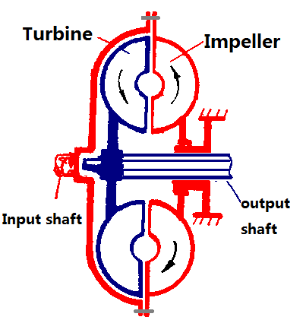
液力耦合器
Fluid Coupling
涡轮
泵轮
输入轴
输出轴

Slide 9
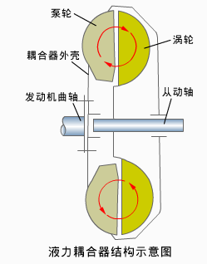
液力耦合器结构
The structure of fluid coupling
液力耦合器主要由泵轮、涡轮、耦合器外壳等组成。Hydraulic coupler mainly contains impeller, turbine, shell.
impeller
turbine
shell
engine crankshaft
driven shaft
泵轮与发动机曲轴相连，是耦合器的主动元件。The impeller which is connected to engine crankshaft is the active component.
涡轮与从动轴相连，是耦合器的从动元件。The turbine which is connected to driven shaft is the driven component.
Schematic diagram of the fluid coupling

Slide 10
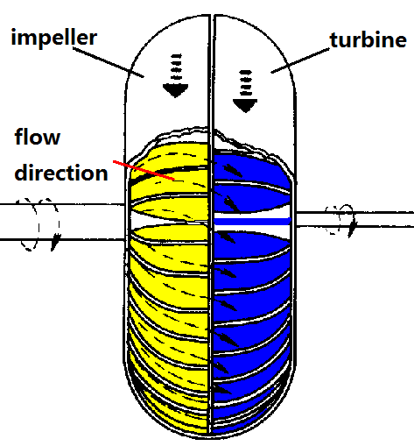
液力耦合器结构
The structure of fluid coupling
泵轮与涡轮统称工作轮，二者之间没有机械联系，靠液体流动来传递动力。There is no mechanical connection between the impeller and the turbine , which are called as running wheel 工作轮and rely on the flowing fluid to transmit the power.
泵轮
涡轮
在工作轮组成的环状壳体中径向排列着许多叶片。工作液存储在环状壳体中。There are many vanes arranged along the radial direction of the annular shell composed by the running wheel. The working fluid is stored in the annular shell.
液流方向
泵轮与涡轮装合后，两者之间有一定间隙（3~4mm），通过轴线的纵断面呈环形，称为循环圆。After assembled, there is a certain gap (3~4mm) between the impeller and the turbine, the longitudinal section through the axis is annular, which is called as circular circle环形环.

Slide 11
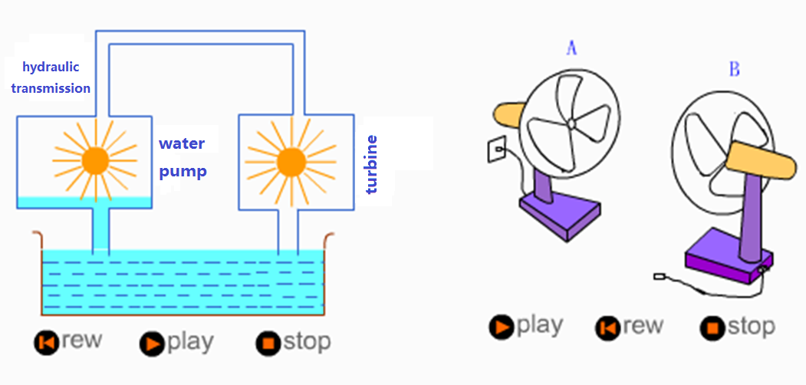
液力耦合器的工作原理
The operating principle of fluid coupling
液力传动
水轮机
水泵

Slide 12
液力耦合器的工作过程
The working process of fluid coupling
当工作轮旋转时，工作液被叶片带动一起旋转。When the running wheel is rotating, the working fluid is driven to rotate together by the vanes.
泵轮
涡轮
在离心力作用下，工作液从叶片内缘流向外缘。As the effect of the centrifugal force, the working fluid flows from the inner edge to the outer edge of the vane.
液流方向
叶片外缘处压力高，而内缘处压力低。The pressure of the outer is high while the inner is low.
叶片内外缘处压力差取决于工作轮半径和转速。The pressure difference between the inner and the outer of the vane depends on the radius and speed of the running wheel.

Slide 13
液力耦合器的工作过程
The working process of fluid coupling
泵轮和涡轮的半径相等。The radius of the impeller equals to that of the turbine.
泵轮
涡轮
当泵轮转速大于涡轮转速时，泵轮叶片外缘的液压大于涡轮叶片外缘的液压。When the speed of the impeller is higher than that of the turbine, the hydraulic pressure of the outer edge of the impeller vane is higher than that of the turbine vane.
工作液不仅随着工作轮绕曲轴和从动轴作圆周运动，在压力差的作用下，还沿循环圆依箭头所示方向作循环运动The working fluid not only does circular motion following the running wheel around the crankshaft and the driven shaft, but also, under the pressure difference, does cyclic motion along the direction indicated by the arrow of the circular circle.
液流方向
液体质点的流线会形成一个首尾相连的环形螺旋线。The flow line of the liquid particles forms a both linked annular helix line.

Slide 14
液力耦合器的工作过程
The working process of fluid coupling
泵轮对工作液做功，使之从泵轮叶片内缘流向外缘的过程中，其圆周速度和动能渐次增加；The impeller apply work to the working fluid, so that during flowing from the inner to the outer edge of the impeller vane, the Circumferential velocity and kinetic energy of the fluid is gradually increased;
工作液从涡轮叶片外缘流向内缘的过程中，其圆周速度和动能渐次减小。During flowing from the outer to the inner edge of the turbine vane, the circumferential velocity and kinetic energy of the fluid is gradually decreased.
泵轮
涡轮
液力耦合器的工作过程是：泵轮接受发动机传来的机械能，并将其传给工作液，这时工作液的动能升高，然后再由工作液将动能传给涡轮，并由涡轮将动力输出The working process of fluid coupling: the impeller accepts mechanical energy from the engine and passes it to the working fluid, then the kinetic energy of the fluid increases and passes the energy to the turbine, finally the turbine outputs power.
液流方向
曲轴
crankshaft
输入轴
Input shaft
泵轮
impeller
涡轮
turbine
输出轴
Output shaft

Slide 15
液力耦合器实现传动的必要条件
The necessary condition of the transmission of fluid coupling
液力偶合器实现传动的必要条件是工作液在泵轮和涡轮之间有循环流动。The necessary condition: It exists circular flow of the working fluid between the impeller and the turbine.
工作液的循环流动是由于两工作轮转速不等，使两轮叶片的外缘产生液压差所致。The reason of the circular flow of the working fluid is that it exists pressure difference in the outer edge of the working wheel vane which is attributed to the difference of the two working wheels speeds.
液力耦合器正常工作时，泵轮转速总是大于涡轮转速。when the hydraulic coupler works properly, the impeller speed is always faster than the turbine speed.
若两轮转速相等，则液力耦合器不起传动作用。If the two speeds are equal, the hydraulic coupler doesn’t drive.

Slide 16
液力耦合器的工作过程（举例）
The working process of hydraulic coupler (for example)
汽车起步Car starting
发动机曲轴带动泵轮旋转；The engine crankshaft drives the impeller to rotate;
涡轮与传动系处于静止状态。The turbine and drivetrain still are in a quiescent state.
泵轮带动工作液对涡轮做功，并产生转矩The impeller drives the working fluid to do work to the turbine and engenders torque.
发动机转速增高，上述转矩增大，并克服汽车的起步阻力。With the engine speed increasing, the torque is increased and overcomes the car starting resistance.

Slide 17
汽车上采用液力耦合器的优缺点
The pros and cons of using hydraulic coupler in the car
优点Advantage
泵轮与涡轮之间允许较大的转速差，可以保证汽车的平稳起步和加速；It allows greater speed difference between the impeller and the turbine, and can ensure a smooth start-up and acceleration of the car;
同时衰减系统扭转振动引起的过载； At the same time ,damps the system overload caused by torsional vibration
延长传动系统的使用寿命；Extend the driveline’s working life ;
在暂时停车时可以不脱开传动系统，减少换档的次数。When temporary parking, it may not be disengaged from the driveline, to reduce the number of gear shifting.
缺点Disadvantage
液力耦合器只能传递扭矩，而不能改变扭矩的大小，因此必须与变速机构一起使用；The hydraulic coupler can only transfer torque without changing the size, it must be used in conjunction with the transmission mechanism；
在耦合器与变速器之间必须加装离合器；It must add the clutch between coupling and transmission;
增加传动系统质量和尺寸；Increase the quality and size of the transmission system;
存在液流损失，传动系统效率比单用离合器低。It exists losing of liquid flow , the efficient of the system is less than that of single clutch.
目前在汽车上的应用逐渐减少。Currently, the application in the automotive is gradually reduced.

Slide 18
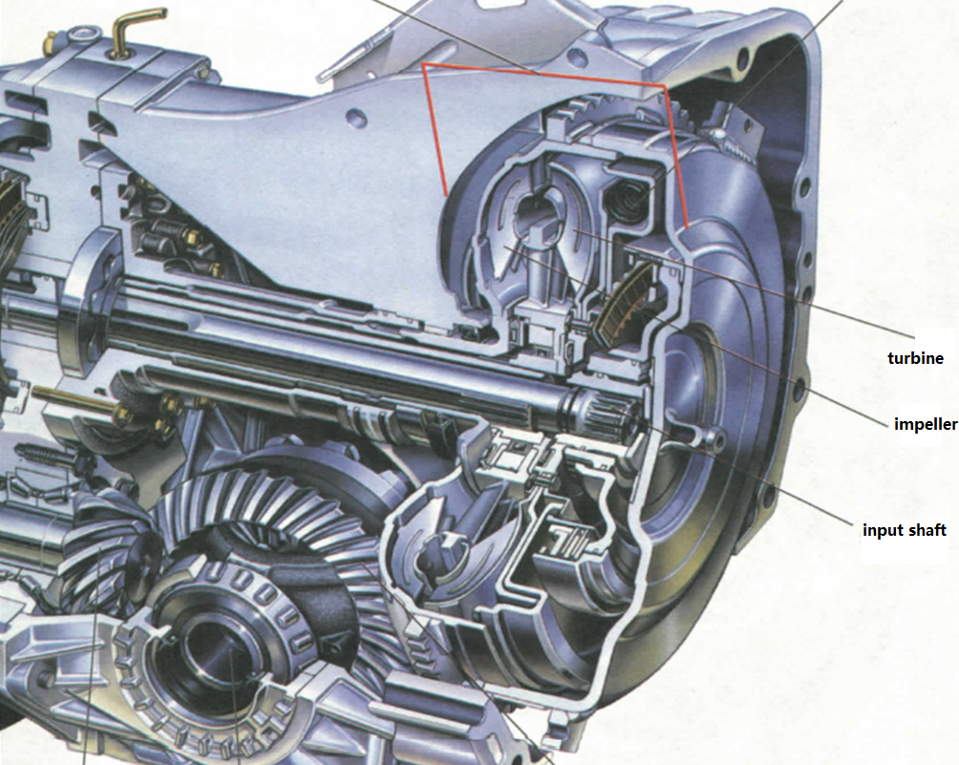
液力变矩器Torque converter
涡轮
泵轮
动力输出轴

Slide 19
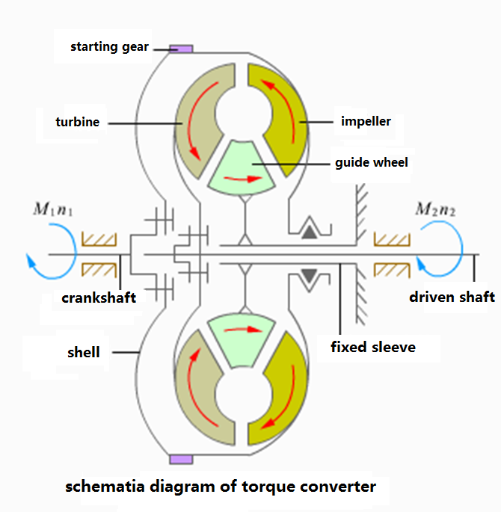
液力变矩器结构
The structure of torque converter
启动齿轮
组成：泵轮、涡轮、导轮。 Composition: impeller，turbine，reactor (guide wheel, stator)
泵轮
涡轮
导轮
固定在固定套管上。 Fixed to the fixed sleeve
固定在输出轴上。Fixed to the output shaft.
从动轴
发动机曲轴
固定在发动机曲轴上。Fixed to the engine crankshaft.

Slide 20
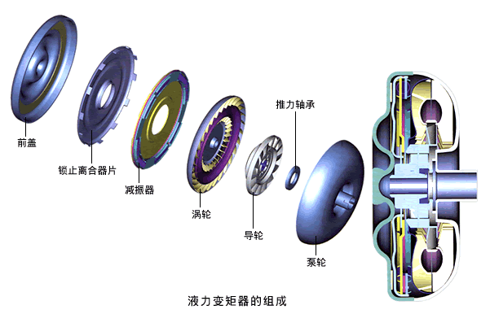
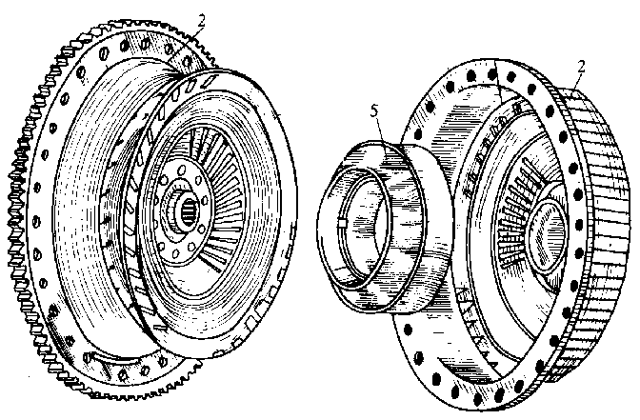
液力变矩器结构
The structure of torque converter
飞轮
导轮
变矩器壳
涡轮
泵轮

Slide 21
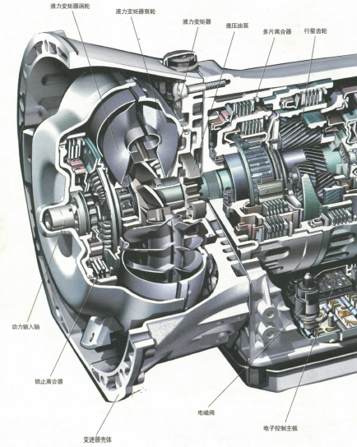
液力变矩器结构
The structure of torque converter

Slide 22
液力变矩器结构
The structure of torque converter
启动齿轮
与液力耦合器相同之处
Common points with fluid coupling
工作轮在装配后形成断面为循环圆的环状体；After assembled, the longitudinal section of the working wheels is the annular body of the circular circle.
工作时，工作液除绕轴作圆周运动外，还作循环流动，能将转矩从泵轮传到涡轮。 During working, the working fluid not only does circular motion, but also does circular flow, and can transfer torque from the impeller to the turbine
泵轮
涡轮
导轮
发动机曲轴
从动轴

Slide 23
液力变矩器结构
The structure of torque converter
与液力耦合器不同之处：
The difference with hydraulic coupler：不仅能传递转矩，而且能在泵轮转矩不变的情况下，随涡轮的转速（车速）不同而改变涡轮输出的转矩值。It not only can transfer torque, but also can change the outputting torque value of the turbine with the turbine speed (vehicle speed)in the case of the impeller torque is constant.
启动齿轮
泵轮
涡轮
导轮
发动机曲轴
从动轴
在结构上多了导轮机构。Structurally , adding guide wheel mechanism.
通过导轮给涡轮反力矩来改变涡轮输出的转矩。Change the outputting torque value of the turbine through using the guide wheel to do counter-torque to the turbine.

Slide 24
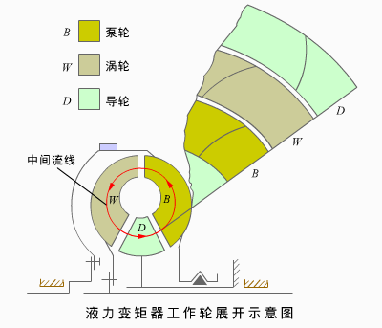
液力变矩器的工作原理
The operating principle of torque converter
中间流线：将流道分割成面积相等的两部分的流线。Center line of flow path：The flow line that divides the flow path into two equal parts.
将循环圆的中间流线展开一条直线。Unfold the center line of flow path of the circular circle, and receive a straight line.
若各循环圆中间流线均在同一平面上展开，则泵轮B、涡轮W和导轮D便成为三个环形平面。If the center line of flow path of every circular circle are unfolded on a same plane, the impeller B、turbine W and guide wheel D will become three annular plane.
假定发动机转速及负荷不变，即变矩器泵轮转速n_{b}及转矩M_{b}为常数。Assume that the engine speed and load are constant, i.e. the impeller speed nb and torque Wb are constants.

Slide 25
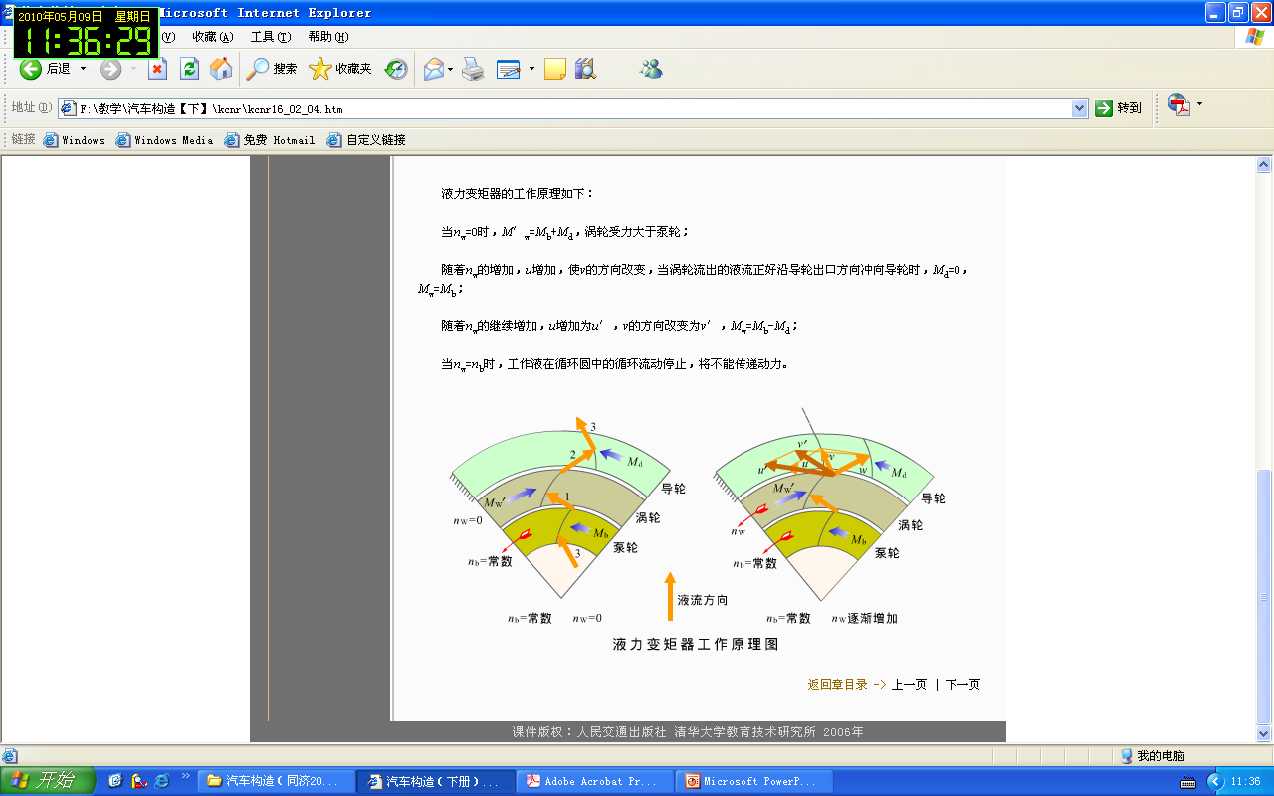
液力变矩器的工作原理（起步工况）
The operating principle of torque converter(starting condition)
设泵轮、导轮、涡轮对工作液的作用转矩为：M_{b} 、M_{d} 、 M’_{w}，则有：
M’ _{w} =M_{b} + M_{d}
注意： M_{w} = －M’_{w}（M_{w}为涡轮输出转矩）Given the torque of impeller, guide wheel and turbine to the working fluid are M_{b} ,M_{d} and M’_{w}, then: M’ _{w} =M_{b} + M_{d}
Attention： M_{w} = －M’_{w}(M_{w} is the output torque of turbine）
涡轮转矩等于泵轮转矩与导轮转矩之和；Turbine torque is equal to the impeller torque plus guide wheel torque.
涡轮转矩大于泵轮转矩，液力变矩器起到了增大转矩作用。The turbine torque is greater than the impeller torque, torque converter has played a role of increasing torque.

Slide 26
液力变矩器的工作原理（加速工况）
The operating principle of torque converter (accelerating condition)
此时工作液在涡轮叶片出口处的绝对速度为：In this case, the absolute velocity of the working fluid at the outlet of the turbine vanes is:
v= w + u
u—牵连速度；- transport velocity;
w—沿叶片的相对速度。relative velocity along the vane;
冲向导轮叶片的绝对速度v随着牵连速度u的增加（即涡轮转速n_{w}的增加）而逐渐向左倾斜，使导轮所受转矩M_{d}逐渐减小。The absolute velocity v that rushed to guide wheel vane gradually tilted to the left as the transport velocity u increases (i.e. turbine speed n_{w} increases),so that the torque M_{d} that the guide wheel is suffered gradually decreases.

Slide 27
液力变矩器的工作原理（加速工况）
The operating principle of torque converter (accelerating condition)
当v与导轮的出口方向一致时：When the direction of v is the same as the direction of the guide wheel outlet:
M_{d}=0
此时：M_{w}=M_{b}，变矩器由变矩变为耦合工况。Now: M_{w}=M_{b}, turbine converter turns into coupling condition from variable torque condition.
n_{w} 继续增大，V继续向左倾斜，M_{d}变为负值； n_{w} increases continuously, V tilted to the left continuously ,M_{d} turns into negative;
此时： Now: M_{w}=M_{b}－ M_{d}
直至:n_{w} = n_{b}，工作液在循环圆中的流动停止，不能传递。Up to :n_{w} = n_{b}，the working fluid stop flowing in the circular circle and cannot transfer power.

Slide 28
液力变矩器的工作原理
The operating principle of torque converter
液力变矩器的输出转矩可以根据涡轮的转速变化
The output torque of turbine converter can be based on the variation of turbine speed:
涡轮速度低——转矩大于泵轮转矩；Turbine speed is low—the output torque is greater than impeller torque;
涡轮速度等于一设定值——转矩等于泵轮转矩；Turbine speed is equal to a set value—the output is equal to impeller torque;
涡轮速度高——转矩小于泵轮转矩；Turbine speed is high—the output torque is less than impeller torque;
涡轮速度等于泵轮速度——不传递转矩。 Turbine speed is equal to impeller speed—it doesn’t transfer torque.
液力变矩器能够改变扭矩的原因是在泵轮和涡轮之间加入了导轮。Thanks to adding guide wheel between impeller and turbine, torque converter can change the value of the output torque.

Slide 29
液力变矩器分析结论
The analysis conclusion of torque converter
泵轮、涡轮和导轮三个工作轮是转换能量，传递动力和实现变矩的基本元件；Impeller, turbine and guide wheel, those three working wheels are the basic components of converting energy, transmitting power and changing torque.
液体同时绕工作轮轴线作旋转运动和沿循环圆作轴向循环运动；The fluid does rotation motion around the axis of the working wheel and does axial circular motion along circular circle simultaneously.
变矩器输出转矩随涡轮的转速而变化 。 The output torque of torque converter varies along with the turbine rotational speed.

Slide 30
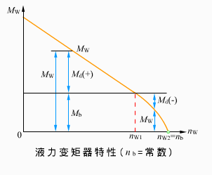
液力变矩器特性
The characteristics of torque converter
液力变矩器特性：变矩器在泵轮转速n_{b}和转矩M_{b}不变的条件下，涡轮转矩M_{w}随其转速n_{w}变化的规律。The characteristics of torque converter: the low of torque converter that turbine torque Mw varies with its speed nw under the condition that impeller speed nb and torque Mb are constant.
表征液力变矩器特性的参数为传动比i和变矩系数K。The parameters that characterizes the torque converter characteristics are transmission ratio I and torque coefficient k.
传动比i定义为输出转速与输入转速之比：i=n_{w}/n_{b}<=1 The definition of transmission ratio is the ratio of the output speed and the input speed: i=nw/nb<=1
变矩系数K定义为输出转矩与输入转矩之比：k=M_{w}/M_{b}The definition of torque coefficient k is the ratio of the output torque of the input torque: k=Mw/Mb
最大变矩系数K出现在什么时候？When is the torque coefficient k maximum?
思考question

Slide 31
液力变矩器特性
The characteristics of torque converter
变矩系数K随涡轮转速的改变而连续变化。Torque coefficient k changes continuously with the change of turbine speed
液力变矩器是一种能随汽车行驶阻力的不同而自动改变变矩系数的无级变速器。Torque converter is a kind of CVT which can change torque coefficient automatically along with the change of the driving resistance.
液力变矩器特性同时反映了变矩系数K与涡轮转速n_{w}（或传动比i）之间的关系。The torque converter characteristics reflects the relationship of toque coefficient k and turbine speed (or transmission ratio i).

Slide 32
液力变矩器特性小结
Summary of the torque converter characteristics
液力变矩器的传动比为小于等于1的连续可变的数；The transmission ratio of torque converter is a continuously variable number which is less than or equal to 1;
液力变矩器的转矩随着汽车的行驶工况自动的改变The torque converter torque changes along with the change of car driving conditions automatically.
当涡轮的速度低时具有较大的转矩；When the turbine speed is low, it has a relatively large torque;
涡轮速度为0时的转矩最大；When the turbine speed is 0, it has the maximum torque;
当涡轮的速度高时具有较小的转矩；When the turbine speed is high, it has a relatively small torque ；
涡轮速度与泵轮的速度相等时的转矩最小为0；When the turbine speed is equal to the impeller speed, it has the minimum torque which is 0.
在涡轮速度高于n_{k=1}时，涡轮的输出转矩小于泵轮的输入转矩，效率低、降低了动力性。When the turbine speed is higher than nk=1, the output torque of turbine is less than that of impeller, the efficiency is low, and it reduces the power performance.
液力变矩器同时具有液力耦合器保证汽车平稳起步，衰减传动系的扭转振动，防止系统过载的特点。Torque converter has the same characteristics as hydraulic couple , such as ensuring a smooth starting, damping the torsional vibration of transmission system, avoiding the system overload.

Slide 33
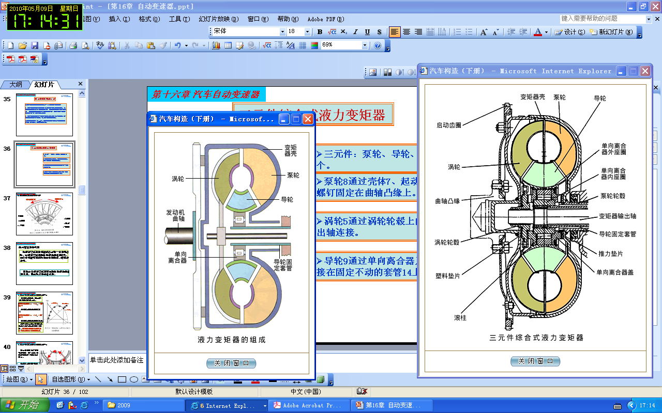
三元件综合式液力变矩器
Three-component torque converter
三元件：泵轮、导轮、涡轮各1个。Three components: a impeller, a guide wheel, a turbine
泵轮通过壳体、起动齿圈托盘、螺钉固定在曲轴凸缘上。The impeller is fixed to crankshaft flange through shell, staring ring gear tray and screws.
涡轮通过涡轮轮毂上的花键与输出轴连接。The turbine is connected to the output shaft through the splines of the turbine hub.
导轮通过单向离合器及其花键连接在固定不动的套管上。Guide wheel is connected to the fixed casing through one-way clutch and its splines.

Slide 34
单向离合器的作用
The role of the one-way clutch
在液力变矩器的涡轮速度达到一定的程度时，让液力变矩器转化为液力耦合器工作，以增大涡轮在高速时的输出的转矩，提高动力性。When the turbine speed of torque converter reaches a certain level, torque converter converts to work as hydraulic coupler, in order to increase the turbine output torque at high speed and improve power performance.
安装了单向离合器的液力变矩器可以转化为液力耦合器工况，因此称之为综合式液力变矩器。The torque converter with installing one-way clutch can convert to work as fluid coupling, so that it’s called as comprehensive converter coupling.

Slide 35
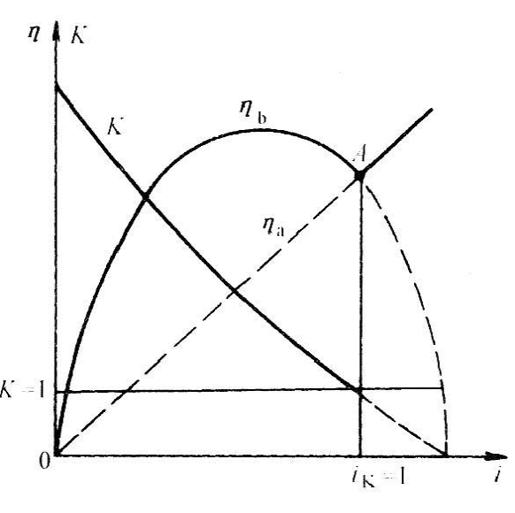
三元件综合式液力变矩器的特性
Three-components torque converter
液力变矩器效率η:涡轮输入功率与泵轮输出功率之比:η=Ki The torque converter efficiency η:the ratio of the turbine input power and the impeller output power: η=Ki
The converter efficiency
变矩器效率
The coupling efficiency
耦合器效率
采用综合式液力变矩器的目的是为了增加变矩器高效区。The purpose of employing converter coupling is broadening the torque converter high efficiency zone;
变矩器转为耦合器工作的点称为工况转换点。The point that converter turn into coupling is called transition point.
工况转换点
Transition point
在变矩系数K>1 （i<i_{k=1}）范围内：变矩器的效率比耦合器高；Within the range of the torque coefficient K>1 (i<i_{k=1}): the efficiency of converter is higher than that of coupling;
在变矩系数K<1 （i>i_{k=1}）范围内：变矩器的效率比耦合器低. When the range of the torque coefficient K<1(i>i_{k=1}): the efficiency of converter is lower than that of coupling;
三元件综合式液力变矩器特性 The three components converter coupling characteristics

Slide 36
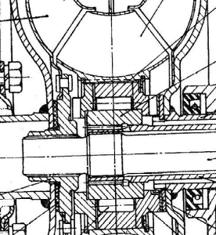
三元件综合式液力变矩器的压力补偿
The pressure compensation of three components converter coupling
液力变矩器为了避免气蚀现象，其中的工作液应该保持一定的补偿压力。In order to avoid the phenomenon of cavitation, the working fluid of torque converter should be kept a certain pressure compensation.
气蚀是指液体流动过程中，某处压力下降到低于该温度下工作液的饱和蒸汽压力时液体形成的气泡现象。Cavitation refers to a phenomenon of the working fluid when during the fluid flowing somewhere pressure drops to be less than the working fluid saturated vapor pressure at this temperature.
补偿压力来自于油泵的补偿油；The compensated pressure comes from the compensated oil of the oil pump;
因为补偿压力的存在，工作轮轴向受力，因此需要考虑磨损问题。Because of the presence of compensated pressure, an axial force acts on the working wheel, so that it should take the attrition into consideration.

Slide 37
三元件综合式液力变矩器的特点
The characteristics of three components converter coupling
结构简单，工作可靠，性能稳定，效率高；Simple structure, reliable work, stable performance, high efficiency;
在变矩器状态下的最高效率为92%；At the state of torque converter, the maximum efficiency can be 92%.
在耦合器状态下的高传动比区的效率可达96%。At the state of coupling and high ratio, the efficiency can reach 96%.

Slide 38
四元件综合式液力变矩器
Four components converter coupling
原因：某些起动变矩系数大三元件液力变矩器在最高效率到耦合工况之间的效率较低。 Reason: some three components converter coupling with large starting torque ratio has relative low efficiency between the maximum efficiency condition and the coupling condition
该区域属于汽车高速行驶区域，属于经常使用的区域This region belongs to a high-speed traveling region and belongs to a region frequently used.

Slide 39
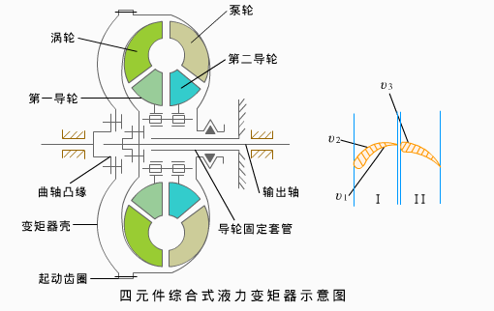
四元件综合式液力变矩器的结构及工作过程
The structure and working process of four components converter coupling
组成：泵轮、导轮1、导轮2、涡轮，共四个元件。Composition: impeller, guide wheel 1, guide wheel 2, turbine, a total of four components.
两个导轮装在各自的单向离合器上。 The two guide wheels are installed in respective one-way clutch.

Slide 40
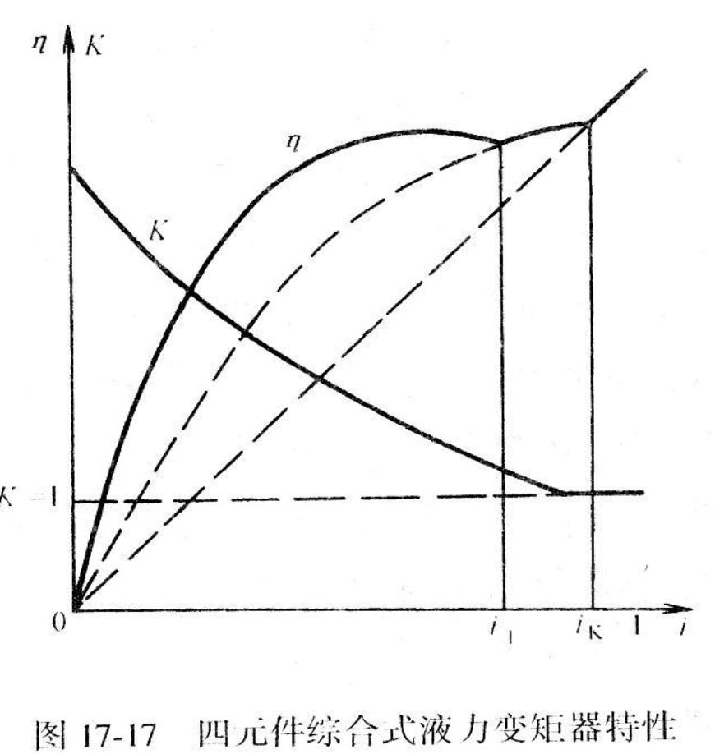
四元件综合式液力变矩器的特性 The characteristics of four components converter coupling
特性：两个变矩特性与一个耦合特性的组合。Characteristics: a combination of two torque converter characteristics and one coupling characteristics.
具有三个工作状态。Having three working state.
在传动比0~i₁区段，两个导轮固定不动，以此在低传动比工况下获得大的变矩系数；At the section of transmission ratio 0~i1, the two guide wheels are fixed immovably, in order to obtain large torque coefficient;
在传动比i₁~i_{K=1}区段，第一导轮脱开，以此得到较高传动效率；At the section of transmission ratio i1_ik=1, the first guide wheel is disengaged in order to obtain a higher transmission efficiency;
在传动比i_{K=1}时，第二导轮脱开，变矩器转入耦合工况，效率按线性规律增长。At the section of transmission ratio ik=1, the second guide wheel is disengaged, converter turns into coupling condition, the efficiency increases linearly.
提高效率的办法：让导轮1与导轮2 先后与涡轮同向旋转。
The way of improving the efficiency: let the guide wheel 1and 2 rotate with the turbine in the same direction one after another.

Slide 41
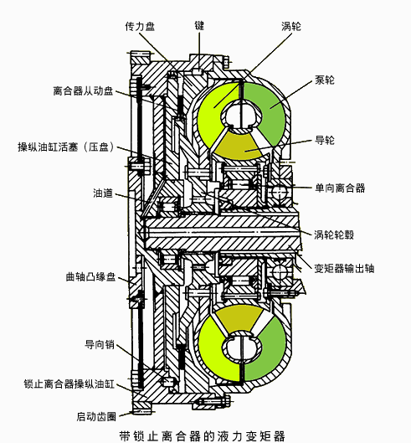
带锁止离合器的液力变矩器
Torque converter with a lock-up clutch
原因：因为液力损失的存在和泵轮与涡轮之间的转速差，液力变矩器的效率比机械传动低，导致燃油经济性差。Reason: because of the presence of the torque loss and the speed difference of turbine and impeller, the torque converter efficiency is less than mechanical transmission efficiency, resulting in poor fuel economy at normal running speed.

Slide 42
带锁止离合器的液力变矩器的结构及工作过程
The structure and working process of the torque converter with a lock-up clutch
锁止离合器的组成Composition
主动部分：油缸活塞、传力盘，与泵轮一起旋转。Active part: the cylinder piston, transmission plate, rotates with the impeller.
从动部分：从动盘，通过铆钉与涡轮轮毂连接，并通过涡轮轮毂花键将动力传给输出轴。Driven part: driven plate, connected to the turbine hub through rivets, and transmitting the power to the output shaft through turbine hub splines.
分离（压紧）部分：油缸与活塞。Separation (compression) part: the oil cylinder and piston.
工作过程：压力油经油道进入后，推动活塞右移，压紧从动盘，将离合器锁止。Working process: the pressure oil come into the oil duct, then push the piston to move right, then compress the driven plate, and lock up the clutch.

Slide 43
带锁止离合器的液力变矩器的作用
The role of torque converter with a lock-up clutch
锁止离合器的作用：在良好的路面上，让液力变矩器被锁止，使液力变矩器的输入轴和输出轴刚性连接（涡轮与泵轮接合成一体），提高传动效率（此时的变矩器效率为1）。The function of lock-up clutch: on a good road surface, the torque converter is locked, let the input shaft connect rigidly with the output shaft of torque converter, in order to increase the transmission efficiency (now, the efficiency is 1).
当汽车在起步或坏路面行驶时，可将锁止离合器分离，使变矩器起作用，以充分发挥变矩器自动适应行驶阻力剧烈变化的优点。When the car is in starting condition or travelling in a bad pavement, it can separate the lock-up clutch and let the converter work, in order to make good use of the characteristics of converter which can automatically adapt to the dramatic changes of driving resistance.

Slide 44
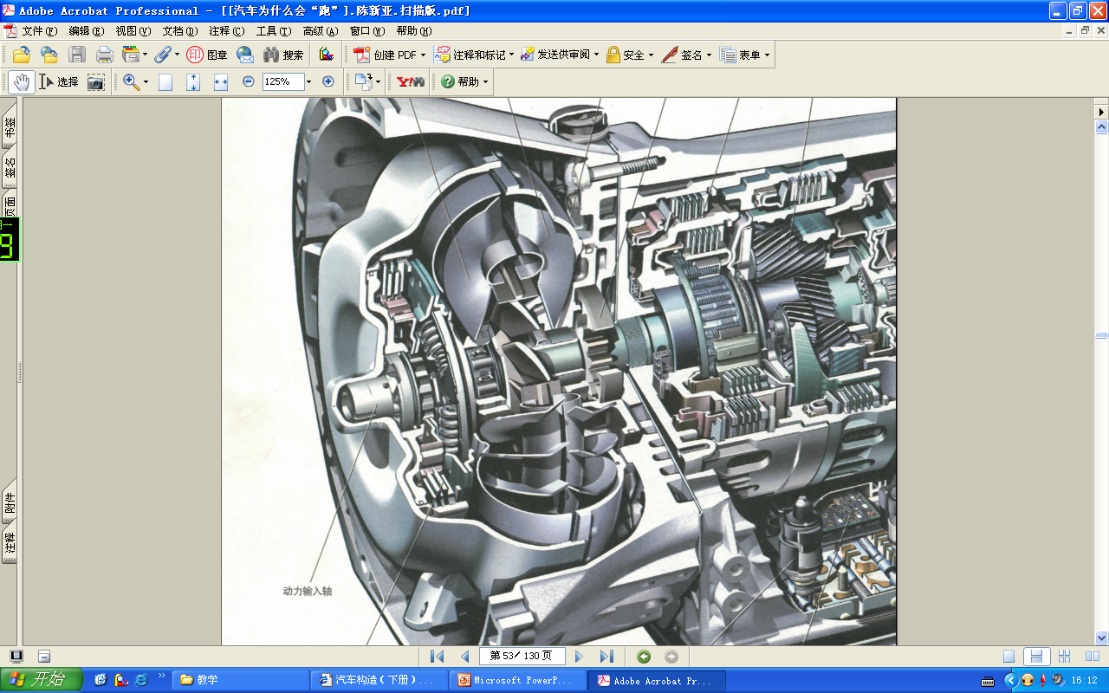
第三节 液力机械变速器
Section 3 Hydraulic Mechanical Transmission

Slide 45
液力机械变速器
Hydraulic Mechanical Transmission
液力变矩器的变矩系数较小，不能满足车辆行驶过程中车速变化的需要；The torque converter torque coefficient is so small that it can’t meet the needs of the speed change during the vehicle running;
过大的变矩系数影响液力变矩器的效率。
Excessively large torque coefficient affects the efficiency of torque converter.
在汽车上广泛采用液力变矩器与齿轮变速器（有级式）共同组成的液力机械变速器。The torque converter that widely used in vehicle together with the gearbox (step-type) composes the hydraulic mechanical transmission.
与液力变矩器配合使用的一般是行星齿轮变速器（轴线旋转式）但也有采用轴线固定式的。Generally the planetary gear transmission (axis rotary type but there is also axis fixed type) is used in conjunction with the torque converter.
行星齿轮变速器结构紧凑，承载能力大，可以用较小的齿轮实现较大的传动比，传动效率高，机构运动平衡，抗振能力强。 The planetary gear transmission has a compact structure, large carrying capacity, the capacity that using relative small gear achieves relative large transmission ratio, high transmission efficiency, kinematic balance, and better ability of anti-vibration.

Slide 46
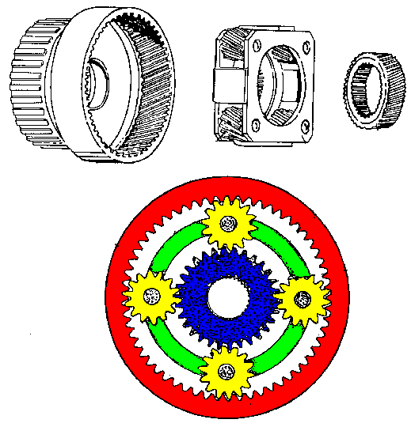
行星齿轮传动机构
Planetary transmission arrangement
行星架Planet carrier
齿圈Ring gear
行星齿轮Planet gear
太阳轮Sun gear

Slide 47
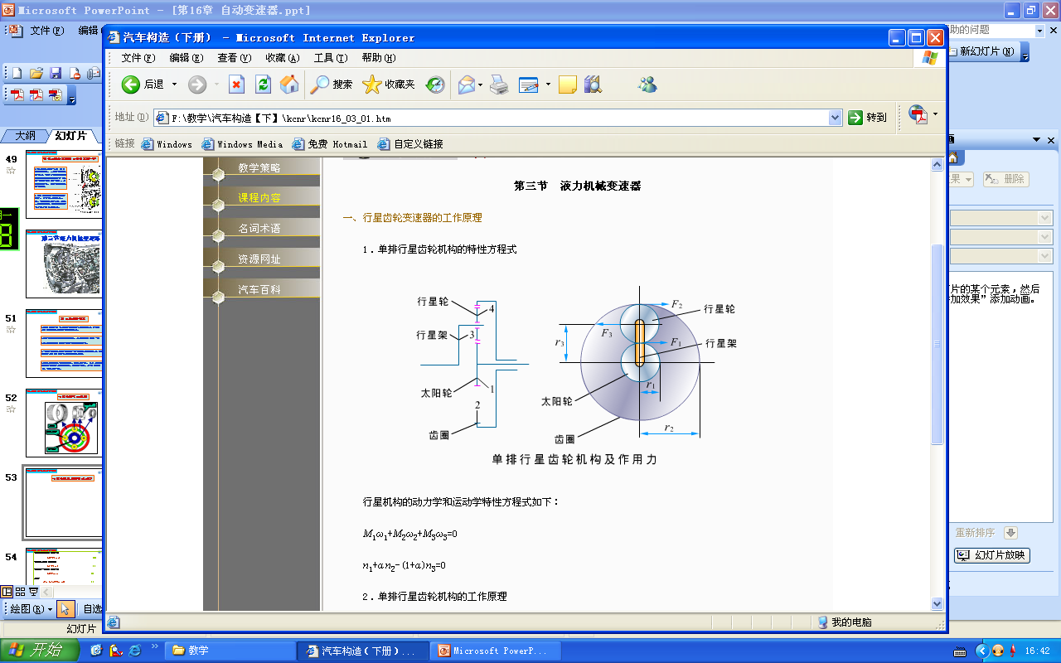
行星齿轮机构的特性方程
The characteristic equation of the planetary gear arrangement
作用在太阳轮1上的力矩：The torque acting on the sun gear 1:
M₁=F₁×r₁ (1)
作用在齿圈2上的力矩： The torque acting on the ring gear 2：
M₂=F₂×r₂ (2)
作用在行星架3上的力矩： The torque acting on planet carrier 3：
M₃=F₃×r₃ (3)
行星轮与太阳轮的中心距为：The center distance of planet gear and sun gear:
r₃=r₁+(r₂-r₁)/2=(r₁+r₂)/2 (4)
设齿圈2与太阳轮1的齿数比为a:Setting the gear ratio of ring gear 2 and sun gear 1 as a:
a=z₂/z₁=r₂/r₁ 即 r₂=a×r₁ (5)
将式（5）代入（4）中得：(5) into (4) is:
r3=(1+a)r1/2 (6)

Slide 48
行星齿轮机构的特性方程
The characteristic equation of the planetary gear arrangement
行星齿轮的平衡条件为：The equilibrium condition of the planetary gear as:
F₁=F₂ (7)
F₃=－2F₁=－2F₂ (8)
将（5）~（8）带入（1）~（3）可以得到：(5)~(8) into (1)~(3) can be:
M₁=F₁×r₁
M2=aF1×r₁ (9)
M3=－(a+1)F1×r1
｛
设w₁，w₂，w₃为太阳轮、齿圈和行星架的角速度，由能量守恒，三个元件上输入和输出功率的代数和为零： Setting w1,w2,w3 is the angular velocity of sun gear, ring gear and planet carrier, according the conservation of energy, the sum of the input and output power of three components is zero.
M1 * w1+M2 * w2+M3 * w3=0 (10)

Slide 49
行星齿轮机构的特性方程
The characteristic equation of the planetary gear arrangement
将（9）带入（10）可以得到行星齿轮机构特性方程：(9) into (10) to obtain the characteristic equation of the planetary gear arrangement:
w₁+a*w₂－(1+a) * w₃ =0 (11)
将角速度替换为转速，则（11）可写为：Replace the angular velocity with rotational speed, then (11)can be written as:
n₁+a*n₂－(1+a) * n₃=0 (12)

Slide 50
行星齿轮机构的特性方程小结
Brief summary of characteristic equation
of planetary gear device
n₁+a*n₂－(1+a) * n₃=0
太阳轮、齿圈与行星齿轮架三者任意一对可作为主从动件，而另一元件固定不动或运动受约束，则整个行星轮系以某一传动比传递动力。The arbitrary pair of the sun gear, the ring gear and the planet carrier can be used as driving components, and the other one is fixed or moving limited, so the planetary gear transmits power in a certain transmission ratio.

Slide 51
行星齿轮机构变速原理
The speed changing principle of the planetary gear arrangement
行星齿轮机构特性方程式：The characteristic equation of the planetary gear arrangement:
n₁+a*n₂－(1+a) * n₃=0
n₁：太阳轮转速 the sun gear rotation speed
Z₁：太阳轮的齿数 the tooth number of sun gear
n₂：齿圈转速 the ring gear rotation speed
Z₂：齿圈的齿数 the tooth number of ring gear
n₃：行星架转速 the planet carrier rotation speed α=Z₂/Z₁

Slide 52
行星齿轮机构传动规律
The transmission rule of the planetary gear arrangement
齿圈2固定，太阳轮1主动，行星架3从动:Ring gear 2 is fixed, sun dear 1 is active, planet carrier 3 is driven:
i₁₃= n₁/ n₃=1+a=1+z₂/z₁>1
减速同向运动。Decelerated and moving in same direction
齿圈2固定，行星架3主动， 太阳轮1从动:Ring gear 2 is fixed, planet carrier 3 is active, sun dear 1 is driven:
i₃₁= n₃/ n₁=a/(1+a）<1
加速同向运动。Accelerated and moving in the same direction

Slide 53
行星齿轮机构传动规律
The transmission rule of the planetary gear arrangement
太阳轮1固定，行星架3主动，齿圈2从动:Sun gear 1 is fixed, planet carrier 3 is active, ring gear 2 is driven:
i₃₂= n₃/ n₂=1/(1+a)<1
加速同向运动。Accelerated and moving in the same direction
太阳轮1固定，齿圈2主动， 行星架3从动:Sun gear 1 is fixed, ring gear 2 is active, planet carrier 3 is driven:
i₂₃= n₂/ n₃=(1+a)/a=1+z₁/z₂>1
减速同向运动。Decelerated and moving in same direction

Slide 54
行星齿轮机构传动规律
The transmission rule of the planetary gear arrangement
行星架3固定，太阳轮1主动， 齿圈2从动:Planet carrier 3 is fixed, sun gear 1 is active, ring gear is driven:
i₁₂= n₁/ n₂=-a=-z₂/z₁<-1
减速反向运动。Decelerated and moving in opposite direction
行星架3固定，齿圈2主动， 太阳轮1从动:Planet carrier 3 is fixed, ring gear 2 is active, sun gear 1 is driven:
i₂₁= n₂/ n₁=-1/a=-z₁/z₂>-1
加速反向运动。Accelerated and moving in opposite direction

Slide 55
行星齿轮机构传动规律
The transmission rule of the planetary gear arrangement
若任意两元件固连，如n₂=n₁，则：Planet carrier 3 is fixed, sun gear 1 is active, ring gear is driven:
n₃=n₁=n₂
第三元件同步旋转，传动比为1，直接档 。Decelerated and moving in same direction
太阳轮、齿圈及行星架三个元件不受约束，自由运动Planet carrier 3 is fixed, ring gear 2 is active, sun gear 1 is driven:
不能传递动力，空挡Accelerated and moving in opposite direction

Slide 56
行星齿轮机构传动规律总结
Summary of the transmission rule of the planetary gear arrangement
方案 | 主动件 | 被动件 | 固定件 | 传动比 | 备注
1 | 太阳轮 | 行星架 | 齿圈 | 1+ α | 减速 增扭
2 | 齿圈 | 行星架 | 太阳轮 | （1+ α ）/ α
3 | 太阳轮 | 齿圈 | 行星架 | － α
4 | 行星架 | 齿圈 | 太阳轮 | α/ （1+ α ） | 增速 减扭
5 | 行星架 | 太阳轮 | 齿圈 | 1 / （1+ α ）
6 | 齿圈 | 太阳轮 | 行星架 | －1/ α
7 | 任意两个连成一体 |  |  | 1 | 直接档
8 | 无任意元件制动又无任二元件连成一体 |  |  | 三元件自由转 | 空档
scheme | Active parts | Driven parts | Fixed parts | Transmission ratio | remark
1 | Sun gear | Planet carrier | Ring gear | 1+ α | Decelerate Increase torque
2 | Ring gear | Planet carrier | Sun gear | （1+ α ）/ α
3 | Sun gear | Ring gear | Planet carrier | － α
4 | Planet carrier | Ring gear | Sun gear | α/ （1+ α ） | Accelerate reduce torque
5 | Planet carrier | Sun gear | Ring gear | 1 / （1+ α ）
6 | Ring gear | Sun gear | Planet carrier | －1/ α
7 | Any two integrally connected |  |  | 1 | Direct gear
8 | Without any element braking nor any two elements integrally connected |  |  | Three components rotate freely | neutral

Slide 57
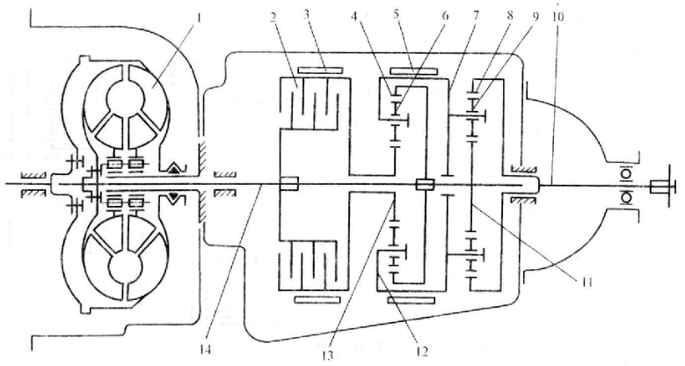
液力变矩器与行星齿轮变速器组成的液力机械变速器
Hydraulic mechanical transmission making up of torque converter and planetary gear transmission
第一轴前端以花键与涡轮轮毂连接，后端支承在第二轴前端中心孔；The front of first shaft in connected to the turbine hub with splines, while the rear end is supported on the center hole of the second shaft front.
第二轴前端以花键与后排行星齿轮机构齿圈连接，后端支承以球轴承在轴管上；The front of the second shaft in connected to the ring gear of the rear row planetary gear arrangement with splines, while the rear end is supported on the axle tube of ball bearing.
前排齿圈与后排太阳轮制成一体，以花键与第一轴连接，为主动件；Manufacture the front row ring gear and the rear row sun gear as a component, and connect to the first shaft with splines, this component is an active part.
后排齿圈与第二轴以花键连接，为从动件；The rear row ring gear is connected to the second shaft with splines and is driven part.

Slide 58
液力变矩器与行星齿轮变速器组成的液力机械变速器
Hydraulic mechanical transmission making up of torque converter and planetary gear transmission
前后两排行星架均以花键与倒档制动鼓5连接，故为刚性连接；The front and back planet carrier are connected to the reverse gear drum brake 5 through splines, it’s rigid connection.
前排太阳轮松套在变速器第一轴上，以花键与低挡制动器3连接；The front row sun gear is sleeved onto the transmission first shaft and is connected to the low gear breaker 3 through splines.
直接挡离合器的主动部分与第一轴连接，从动部分与前排太阳轮连接；The active part of the direct gear clutch is connected to the first shaft, while the driven part is connected to the front row sun gear.
该行星齿轮变速器共有一个倒档和两个前进挡：低速挡和高速挡（直接挡）；This planetary gear transmission totally has one reverse gear and two forward gears: low speed gear and high speed gear (direct gear).

Slide 59
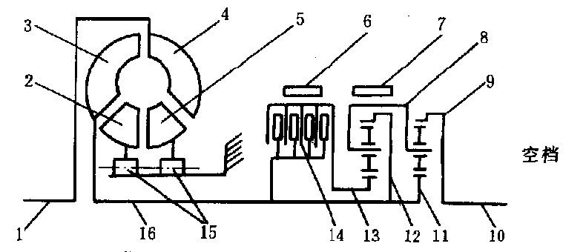
液力变矩器与行星齿轮变速器组成的液力机械变速器
Hydraulic mechanical transmission making up of torque converter and planetary gear transmission
空档：直接档离合器分离、低速档和倒档制动器松开。The neutral: separate the direct gear clutch and release the brake of the low speed gear and reverse gear.

Slide 60
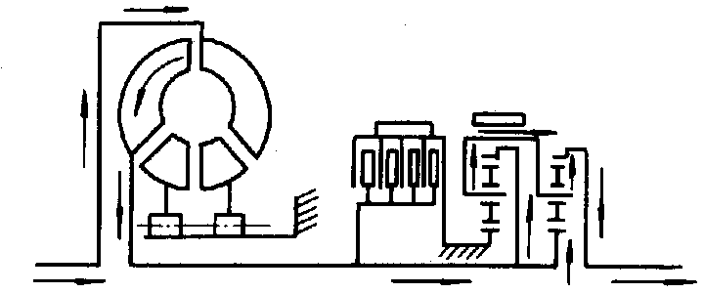
液力变矩器与行星齿轮变速器组成的液力机械变速器
Hydraulic mechanical transmission making up of torque converter and planetary gear transmission
低速挡：直接档离合器分离、倒档制动器松开、低速挡制动器制动。Low speed gear: separate the direct gear clutch, release the reverse gear brake, brake the brake of the low speed gear.
传动比如何计算？How to calculate the transmission ratio?
思考Think
前排齿圈
行星架
后排行星轮
变矩器
输入轴
后排齿圈
输出轴
后排太阳轮
后排行星轮
Front ring gear
carrier
Rear planet gear
converter
Input shaft
Rear ring gear
Output shaft
Rear sun gear
Rear planet gear

Slide 61
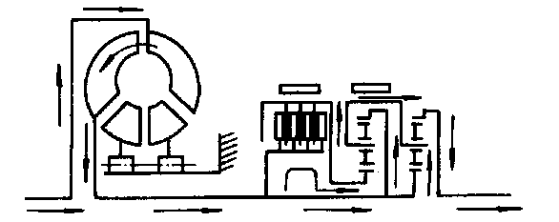
液力变矩器与行星齿轮变速器组成的液力机械变速器
Hydraulic mechanical transmission making up of torque converter and planetary gear transmission
直接挡：直接档离合器结合、倒档制动器松开、低速挡制动器制动。Direct gear: combine direct gear clutch, release the reverse gear brake, brake the low speed gear brake.
变矩器
输入轴
前排齿圈
前排太阳轮
前排行星架
后排行星架
输出轴
后排太阳轮
converter
Input shaft
Front row ring gear
Front row sun gear
Front row planet carrier
Rear row planet carrier
Output shaft
Rear row sun gear

Slide 62
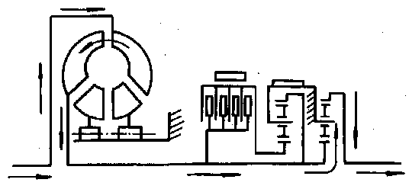
液力变矩器与行星齿轮变速器组成的液力机械变速器
Hydraulic mechanical transmission making up of torque converter and planetary gear transmission
倒挡：直接档离合器结合、倒档制动器结合、低速挡制动器制动。Reverse gear：combine direct gear clutch and the reverse brake, brake the low speed gear brake.
变矩器
输入轴
后排太阳轮
后排行星轮
（换向）
输出轴
Converter
Input shaft
Rear low sun gear
Rear low planet gear
(reversing)
Output shaft

Slide 63
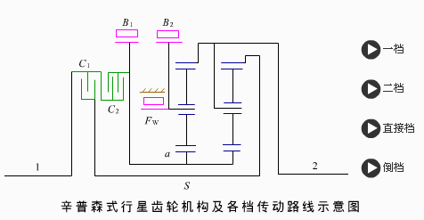
其它形式的行星齿轮机构
Other forms of the planetary gear arrangement
辛普森式：两排行星齿轮机构共用一个太阳轮组成的复合式行星齿轮机构，可获得3个前进挡和1个倒挡。Simpson form: a compound planetary gear arrangement with two rows planetary gear arrangement sharing one sun gear, it can achieve three forward gears and one reverse gear.

Slide 64
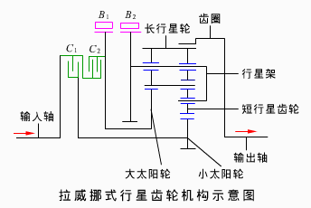
其它形式的行星齿轮机构
Other forms of the planetary gear arrangement
拉威挪式：两排行星齿轮机构共用一个齿圈和行星架，可获得3个前进挡和1个倒挡；Ravigneaux form: two planetary gear arrangement share one ring gear and one planet carrier, it can achieve three forward gears and one reverse gear.
行星架上的长行星轮与前排大太阳轮啮合的同时还与后排短行星轮啮合，短行星轮还与小太阳轮啮合。The long planet gear of the planet carrier meshes with the front row big sun gear and the rear row short planet gear simultaneously, while the short planet gear mesh with the small sun gear.

Slide 65
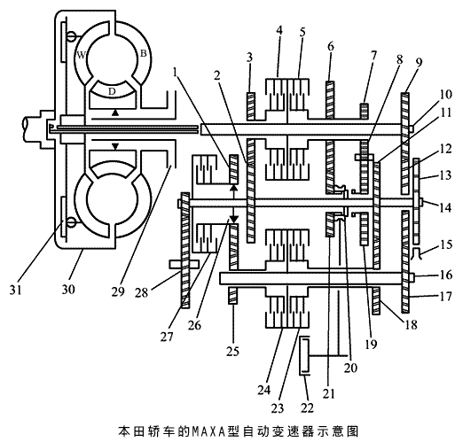
液力变矩器与固定轴线式齿轮变速器组成的液力机械变速器The hydraulic mechanism transmission consists of torque convert and fixed axis gear transmission.

Slide 66
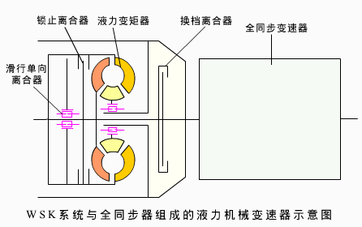
带锁止离合器的液力变矩器、换挡离合器和全同步变速器组成的液力机械变速器
The hydraulic mechanical transmission consists of torque converter with lock-up clutch, shifting clutch and fully synchronous transmission, WSK: Wandlerschaftkupplng
汽车起步或在坏路面行驶时，锁止离合器分离，变矩器起作用；When the car starts or travels on bad road, the lock-up clutch is disengaged and the torque converter works.
汽车在良好的路面行驶时，锁止离合器结合，变矩器不起作用而转为机械传动；When the car travels on good road, the lock-up clutch is engaged, the torque converter doesn’t work and turns into mechanical delivery.

Slide 67
液力机械变速器的总传动比
The total transmission ratio of hydraulic mechanical transmission
液力机械变速器的总传动比为：液力变矩器的变矩系数K与齿轮变速器的传动比i的乘积。The total transmission ratio of the hydraulic mechanical transmission is: the product of the torque converter torque coefficient K and the gearbox transmission ratio i.
I=K*i
传动比越大，液力机械变速器的所传递的转矩越大，转速越低，这点与机械变速箱是一致的。More larger transmission ratio, more larger torque transmitted by the hydraulic mechanical transmission, more lower speed, it’s as the same as the mechanical gearbox.
因为液力变矩器的变矩系数在一定的范围内可以连续变化，配合上机械变速机构后，液力机械变速器的传动比在几个区间内是连续变化的。我们称之为部分无级变速器。Because of the torque coefficient of torque converter can change continuously in a certain range, coordinating with the mechanical transmission mechanism, the transmission ratio of the transmission can change continuously in several ranges. We call this as incomplete CVT.

Slide 68
第四节 自动变速器的操纵机构
Section 4 The operation mechanism of automatic transmission
自动变速器操纵机构可分为液控液压操纵系统和电控液压操纵系统两种；The control mechanism of automatic transmission can be classified into the hydraulic controlled hydraulic acting system and electrical controlled hydraulic acting system.
汽车前进行驶过程中，驾驶员按行驶需要控制加速踏板，变速器根据发动机负荷和汽车行驶速度的变化，自动的换入不同的档位。During the car travelling, driver controls the accelerator pedal according travelling needs, the transmission automatically turns into different gear according the load of engine and the variation of travelling speed.
特点
Characteristics
操纵轻便；Manipulate easily;
换档过程平稳，提高舒适性；Smooth shifting process, improving comfortable quality;
结构复杂；The structure is complex;
工艺复杂。The technology is complex.
组成
Composition
动力源Power source
执行机构Actuator
控制机构Control device

Slide 69
操纵机构的动力源
The power source of control mechanism
向控制机构、执行机构供应压力油实现换挡；Supply pressure oil to the control mechanism and actuator in order to finish shifting;
向液力变矩器供应工作油液；Supply working oil to the torque converter;
向行星齿轮机构供应润滑油。Supply lubricating oil to the planetary gear arrangement.

Slide 70
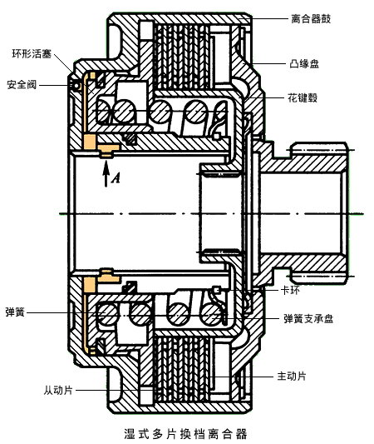
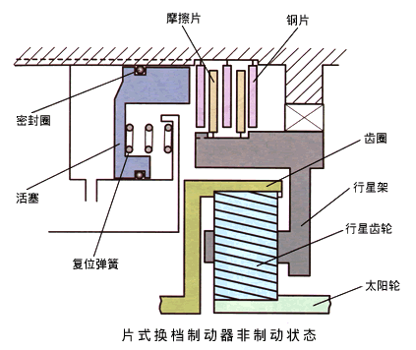
操纵机构的执行机构
The actuator of the control mechanism
组成：直接挡离合器、低挡制动器和倒挡制动器等。Composition: direct gear clutch, low speed gear brake and reverse gear brake and so on.

Slide 71
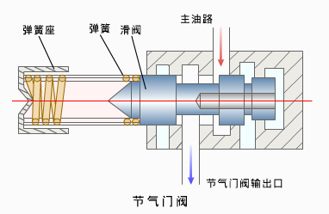
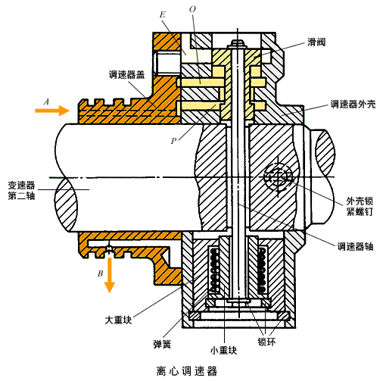
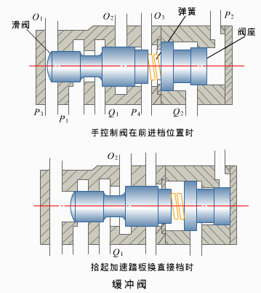
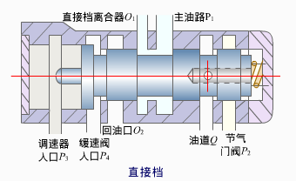
操纵机构的控制机构（液控）
The control mechanism (hydraulic controlled)
根据汽车不同的行驶条件，分别在执行机构中建立或卸除油压，从而得到变速器的不同工作档位。According the car different driving conditions, it establishes and drops the oil pressure, in order to obtain different working gear of the transmission.
组成：主油路系统、换挡信号系统、换挡阀系统、缓冲安全系统和滤清冷却系统等。Components: the main oil system, shifting signal system, shifting valve system, buffer safety system and filter cooling system and so on.

Slide 72
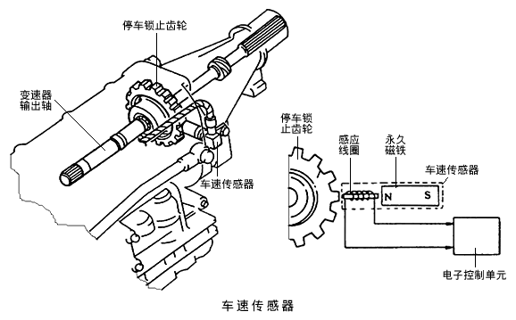
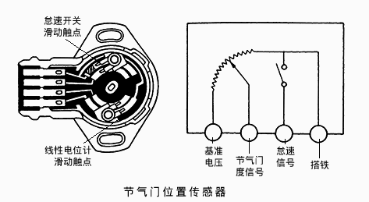
操纵机构的控制机构（电控）
The control system (electrical controlled)
根据汽车不同的行驶条件，分别在执行机构中建立或卸除油压，从而得到变速器的不同工作档位。According to the different driving conditions, it establishes and drops the oil pressure, in order to obtain different working gear of the transmission.
组成：ECU、节气门传感器和车速传感器等。Composition: ECU, throttle sensor and vehicle speed sensor and so on.

Slide 73
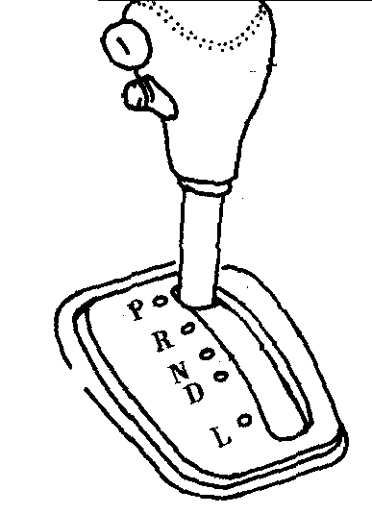
选档杆的使用
The use of shift lever
自动变速箱系统一般只能完成汽车行驶中在一定范围内的升挡和将挡，其它功能必须由驾驶员指令才能动作。The automatic transmission system often can only accomplish changing gear in a certain range during the vehicle driving, the other functions must be acted depending on the driver’s operation command.
锁止按钮Lock-up push button
档位
Gears

Slide 74
各挡位功能
The function of each gear
驻车，输出轴被锁止在变速器壳体上，防驱动轮转动，同时执行元件使AT处于空档状态Parking, the output shaft is locked on the transmission shell, avoid transmission rotating, meanwhile, the implementation component lets AT into neutral state.
实现倒档
Realizing reverse gear
P
R
N
D
2
1
实现空档Realizing neutral
根据车速、节气门开度等变化因素，按照设定的换档规律，自动变换档位According the changing factor such as vehicle speed, throttle opening degree, automatically change gears on the basis of the shifting rules set before.
变速器最高能够升到2、1档 Transmission is able to rise up to 2,1 gears
随意换
Any time
坏路行驶Driving on bad road
Based on speed
视车速
After parking
停车后

Slide 75
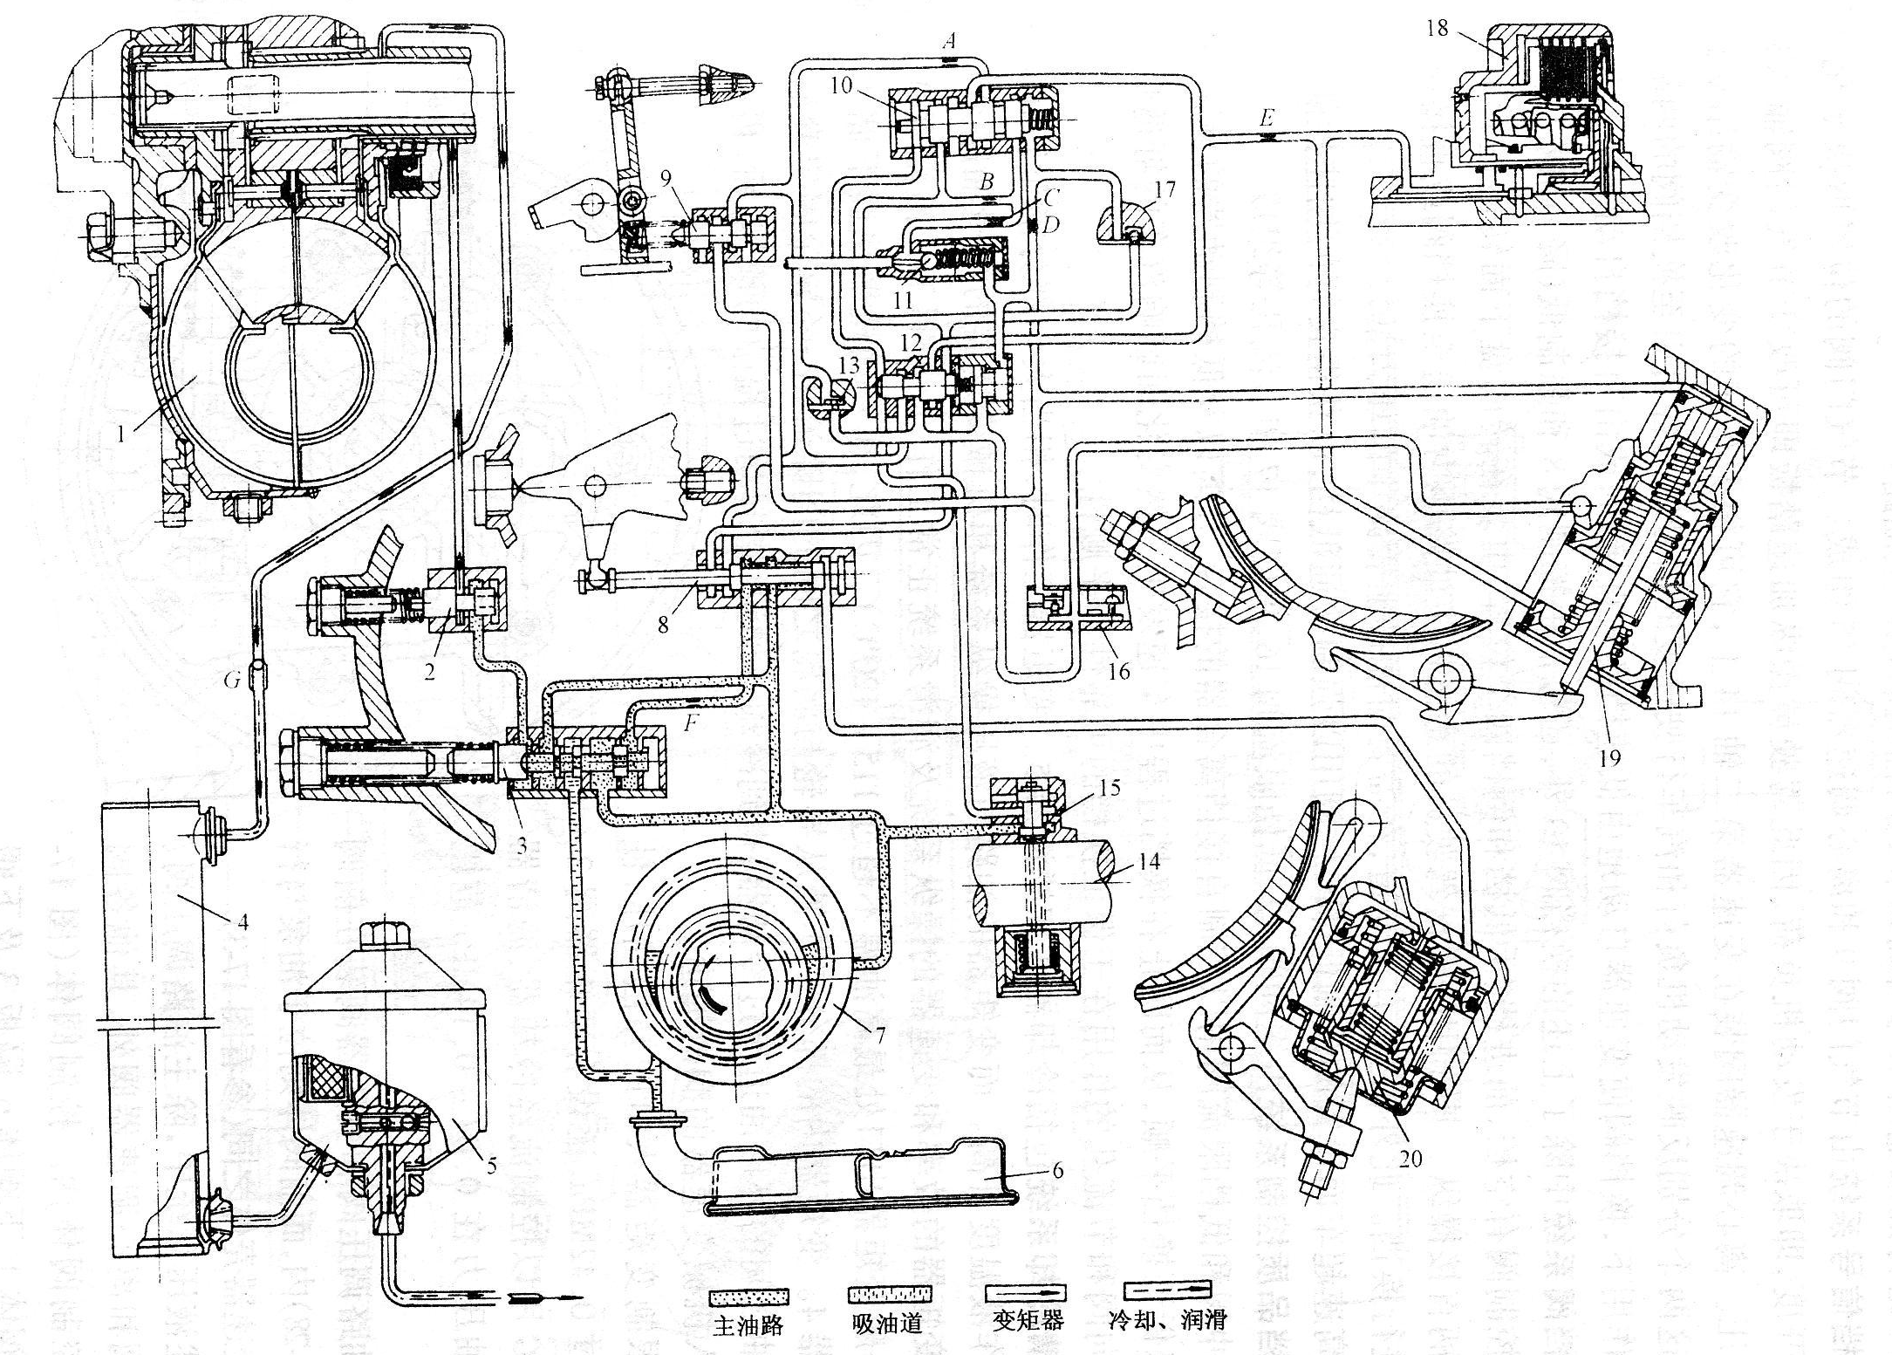
自动变速器液控液压操纵机构
The control mechanism of hydraulic controlled hydraulic AT

Slide 76
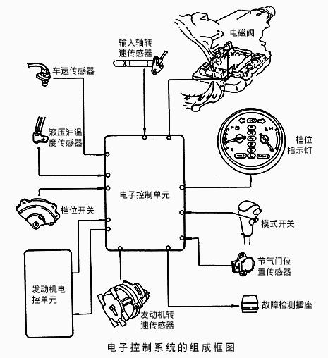
自动变速器电控液压操纵机构
The control mechanism of electronic hydraulic acting AT

Slide 77
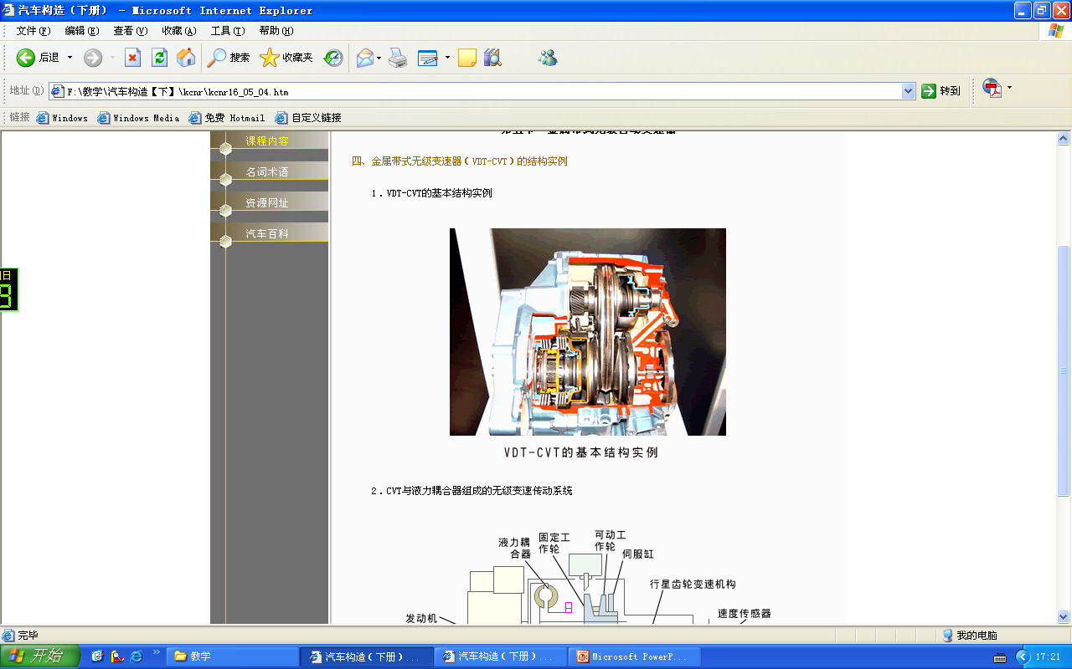
第五节 金属带式无级自动变速器
Section 5 Metal Belt Continuously Variable transmission
机械式无级变速器简称CVT(Continuously Variable Transmission)；Continuously Variable Transmission, i.e. CVT for short;
于20世纪70年代，由荷兰的VDT(VAN Doorne’s Transmission b.V)公司研制成功了新型的金属带式无级自动变速器简称VDT - CVT。In the 1970s, VDT (Van Doorne's Transmission b.V) company from Netherlands successfully developed a new type of metal belt continuously variable transmission called as VDT-CVT for short.

Slide 78
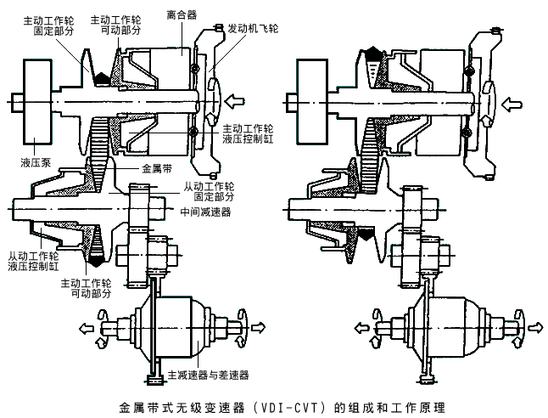
VDT – CVT的结构和工作原理
The structure and working principle of VDT-CVT
组成：金属带、主从动工作轮、液压泵、起步离合器以及控制系统等。 Composition: metal belt, driving-driven working pulley oil pump, starting clutch and control system and so on.
主从动工作轮均可分为固定部分和可动部分，主从动部分装合后形成V型槽； The driving and driven pulley all can be divided into fixed part and moving part, after integrated together driving and driven parts will form a V-groove.
工作原理：当主从动工作轮的可动部分作轴向移动时，金属带与工作轮的啮合半径将改变，从而改变传动比。Working principle: when the moving part of the driving and driven pulleys move along the axial direction, the meshing radius of the metal belt and pulley changes, so that the transmission ratio changes.

Slide 79
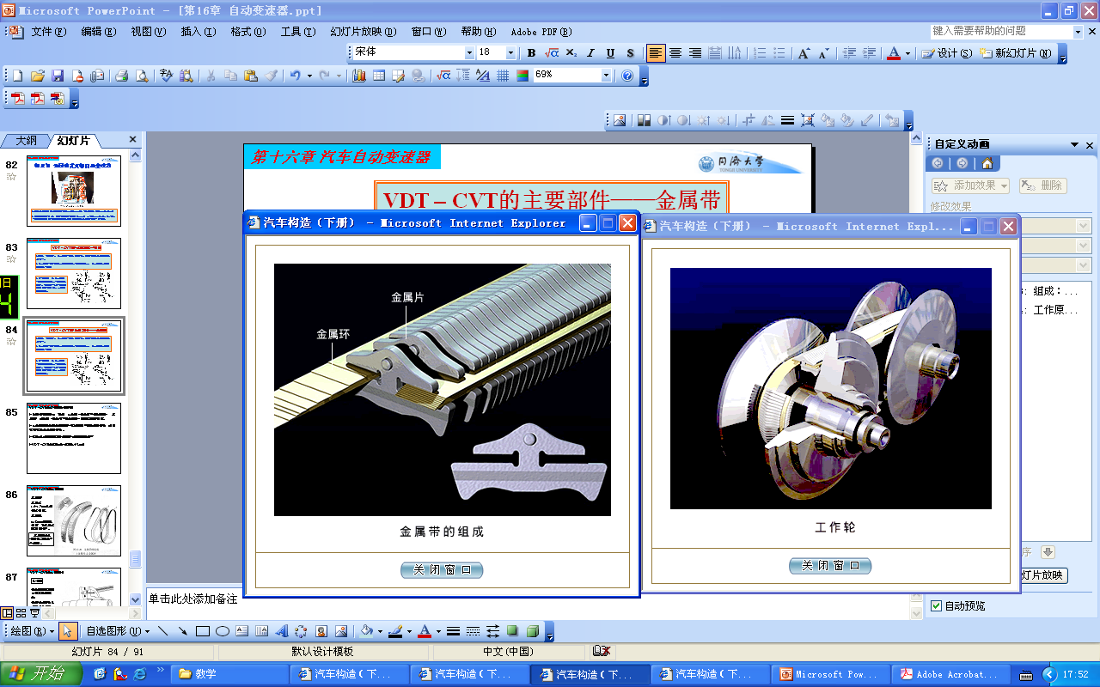
VDT – CVT的主要部件——金属带
The main component of VDT-CVT----metal belt
金属带由金属片和金属环组成，金属片由1.4~1.7mm工具钢片叠成，金属环由0.18mm的带环叠成，对金属片起导向作用。Metal belt is made up of metal sheets and metal rings, metal sheets is superposition of 1.4~1.7mm tool steel sheets, and the metal rings is superposition of 0.18mm rings, have the function of guiding the metal sheets.
金属带的工作表面是它的两个侧面。
The working surfaces of the metal belt are the both sides of it.

Slide 80
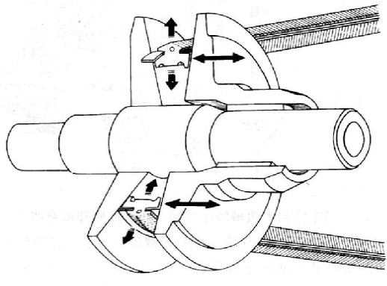
VDT – CVT的主要部件——工作轮
The main component of VDT-CVT----pulley
工作面为直线锥面体，可动部分在液压力作用下可沿轴向移动。The working surface is straight cone, the moving part moves along the axis direction under liquid pressure.
通过液压作用可连续的变化工作轮的工作直径，实现无级变速。It can change the working wheel diameter continuously under the function of liquid pressure, achieving continuously variable speed.

Slide 81
VDT – CVT的主要部件——液压泵
The main component of VDT-CVT ---oil hydraulic pump
液压泵为液压系统提供一定压力的油液，结构形式主要有齿轮泵和叶片泵。
The oil hydraulic pump supplies oil of a certain pressure for hydraulic system, gear pump and vane pump are the main structure forms.

Slide 82
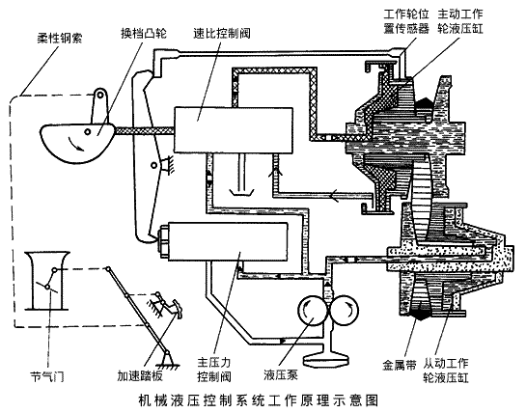
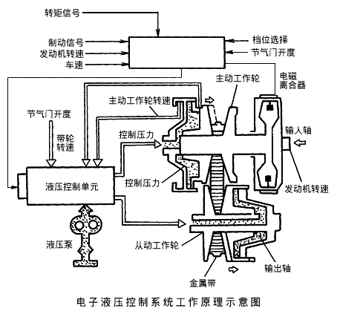
VDT – CVT的主要部件——控制系统
The main component of VDT-CVT---control system

Slide 83
VDT – CVT的缺点
Disadvantages of VDT-CVT
动力源为发动机，工作范围受发动机最低稳定车速的限制；The power source is the engine, the working range is limited by the minimum steady vehicle speed.
起步阶段仍需离合器，起步性能较差；It still needs the clutch when starting, the staring performance is relatively bad
高档传动比太小（0.4左右）。High gear ratio is too small (about 0.4).
与其它传动形式配合使用。
Used in conjunction with other transmission forms.

Slide 84
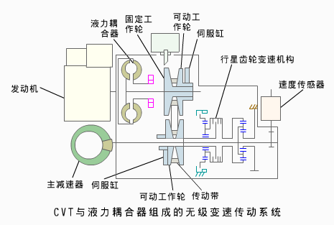
CVT与液力耦合器组成的无级变速器
The continuously variable transmission with CVT and hydraulic coupling

Slide 85
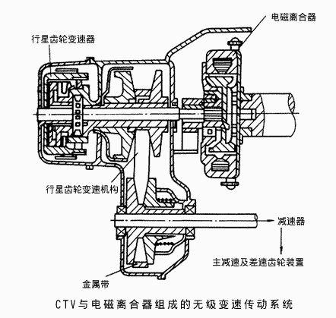
CVT与电磁离合器组成的无级变速器
The continuously variable transmission with CVT and electromagnetic clutch

Slide 86
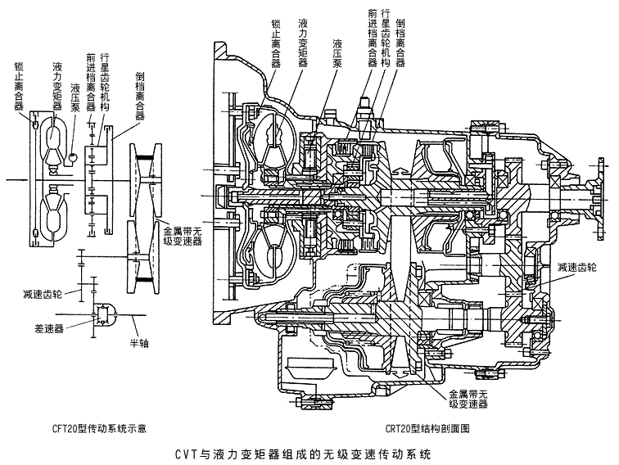
CVT与液力变矩器组成的无级变速器
The continuously variable transmission with CVT and torque converter

Slide 87
VDT-CVT小结
Brief summary of VDT-CVT
结构紧凑，重量轻、成本低的特点，适合于微型和普通轿车；Compact structure, light weight, low cost, suitable for micro and ordinary vehicle;
功率小,不适于高级轿车；Small power, and is not suitable for a limousine;
与发动机之间需要离合器，适应性受发动机最低稳定转速的限制；It needs clutch after the engine, the adaptability is limited by the engine minimum stable speed.
传动比0.4~7，为满足高速档动力，主传动比是普通的2倍，而使发动机工作在非高效区。一般匹配液力变矩器。Transmission ratio from 0.4 to 7, in order to meet high gear power, the main transmission ratio is 2 times of ordinary, so that the engine works in a non-efficient district. Generally match torque converter.

Slide 88
VDT-CVT影音文件播放

Slide 89
本章学习重点
Learning Objectives
液力变矩器的工作原理和液力变矩器的特性；The working principle and characteristics of torque converter;
单向离合器的作用；The rule of one-way clutch;
行星齿轮机构的运动规律；Moving law of planetary gear arrangement;
行星齿轮机构的工作特点；The working characteristics of planetary gear arrangement;
几种不同形式液力机械变速器的换挡原理。Shifting principle of several different hydraulic mechanical transmissions

Slide 90
作业Homework
试述液力变矩器的工作原理和液力变矩器的特性。Elaborate works of the torque converter and torque converter characteristics.
在液力变矩器导轮的轴上为什么要安装单向离合器？Why do we fix one-way clutch to the shaft of the torque convert?
行星齿轮机构的运动规律方程是什么？方程中的各字符的物理意义？Law of motion of the planetary gear mechanism equation? The physical meaning of each character in the equation?
按单排行星齿轮的运动方程，说明行星齿轮机构的工作特点。According the equations of motion by simple planetary gear, declare the characteristics of the planetary gear mechanism.
自动变速箱液控液压式自动操纵系统的执行机构包括什么? The composition of the actuator of the hydraulic controlled hydraulic acting automatic transmission control system?
自动变速箱液控液压式自动操纵系统的控制机构的换档信号系统包括什么? The composition of the signal system of control mechanism of the hydraulic controlled hydraulic acting automatic transmission control system?
自动变速箱液控液压式自动操纵系统的控制机构的换档阀系统包括什么? 它们的作用各是什么? The composition of the shift valve system of control mechanism of the hydraulic controlled hydraulic acting automatic transmission control system and their function?

